Slide 1
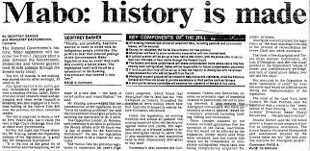
The Mabo Decision
Year 10
Wk 1.2 and 1.3

Slide 2
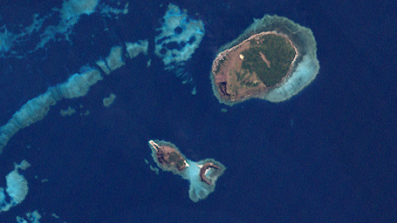
Learning Intention
Success Criteria
I can…
Explain the meaning of Terra Nullius
Outline the impact of the Mabo decision on native title
To investigate the story of Eddie Mabo and discover the impact on the doctrine of Terra Nullius.

Slide 3
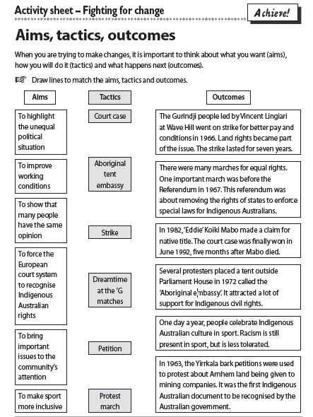
Aims, tactics and outcomes
Last lesson we finished by considering the different ways of processing.
Let us begin today by matching the aims, tactics and outcomes used by the different groups that fought for change on the timeline we looked at.

Slide 4
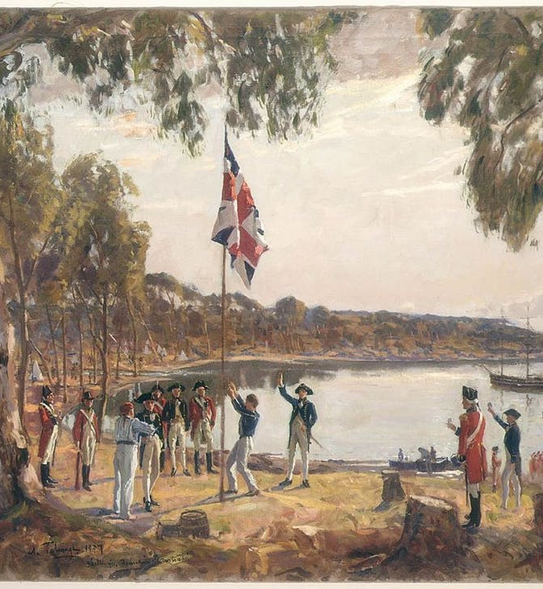
Native Title
Background
The British designated Australia as terra nullius (empty land) to justify their colonisation and settlement of a land that belonged to other people. This decision meant that successive governments had no problem with removing Indigenous Australian peoples from their land.
This view of Australia as empty land was challenged through legal cases like that of Eddie Mabo.

Slide 5
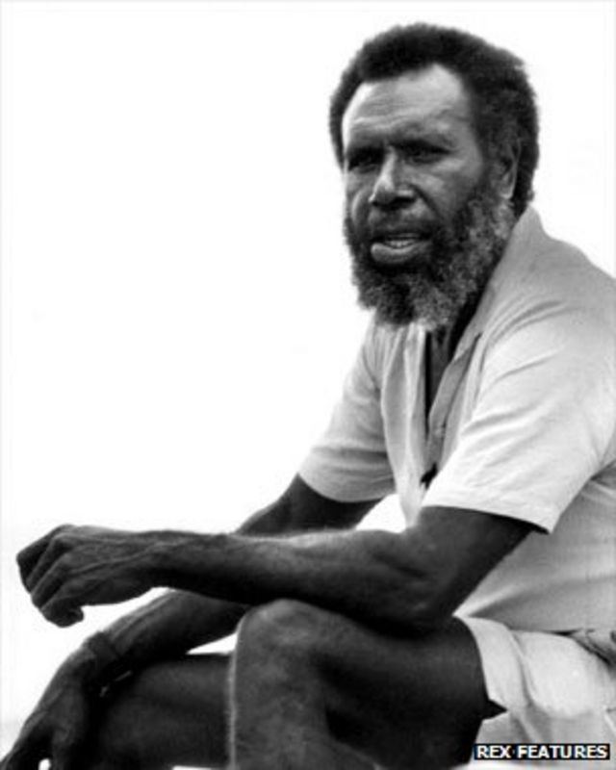

Watch: First Australians – We Are No Longer Shadows
WARNING: Aboriginal and Torres Strait Islander viewers are warned that the following program may contain images and voices of deceased persons.
Eddie Koiki Mabo fights for Australian law to recognise that his people own Murray Island, where they have lived for generations.
Notes:
YouTube: https://www.youtube.com/watch?v=6CSADl_gXZY
Approx 50 mins

Slide 6
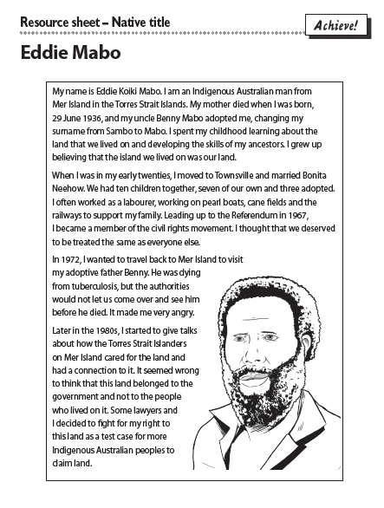
Read the Resource Sheet

Slide 7
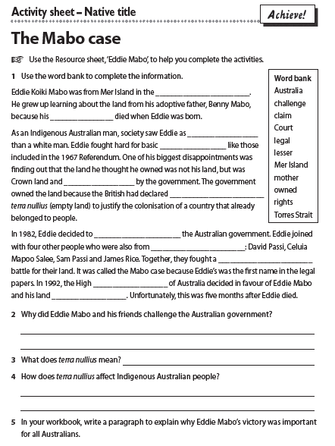
Complete Activity sheet – Native title

Slide 8
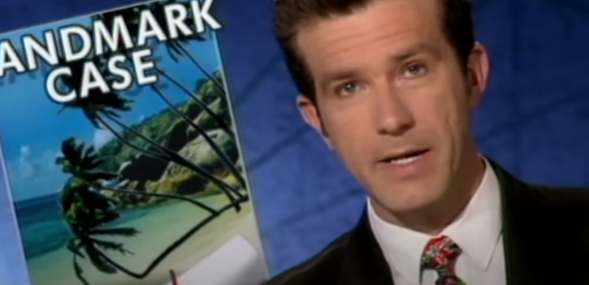
Native Title Act
Watch this review of the Mabo case.

Slide 9
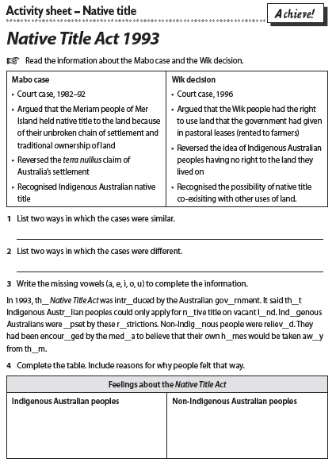
Complete Activity sheet – Native Title Act 1993

Slide 10
Success Criteria
I can…
Explain the meaning of Terra Nullius
Outline the impact of the Mabo decision on native title

